Slide 1
Monthly Armed Robberies in Boston (1966-1975)
By:
Anthony Castillo
Adam Trujillo
Tatiana Moreno
Anton Sunico
William Berman

Slide 2
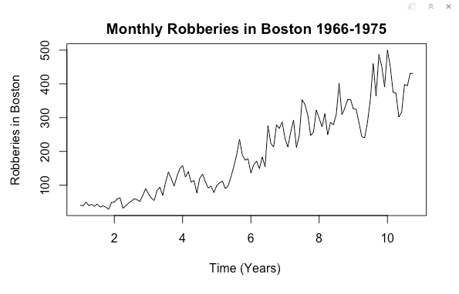
Initial Dataset
Notes:
Upward trend
Slightly increasing variance with time
Possible seasonality

Slide 3
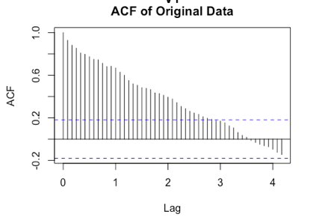
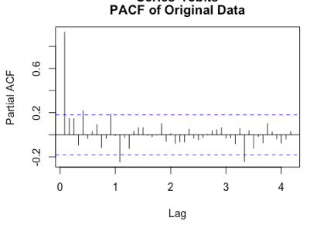
Autocorrelation Analyses
Notes:
Little to no evidence of seasonality
Trend in ACF linked to trend in data

Slide 4
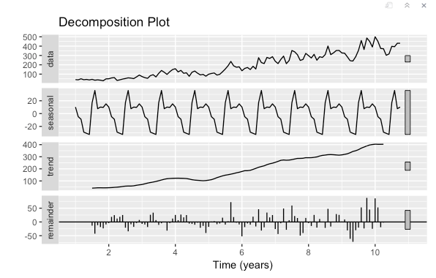
Decomposition
Notes:
Will start:
Additive decomposition
Seasonal
Trend
Noise
Upward trend
Some evidence of seasonality
Increasing variance with time -> Transform Y

Slide 5
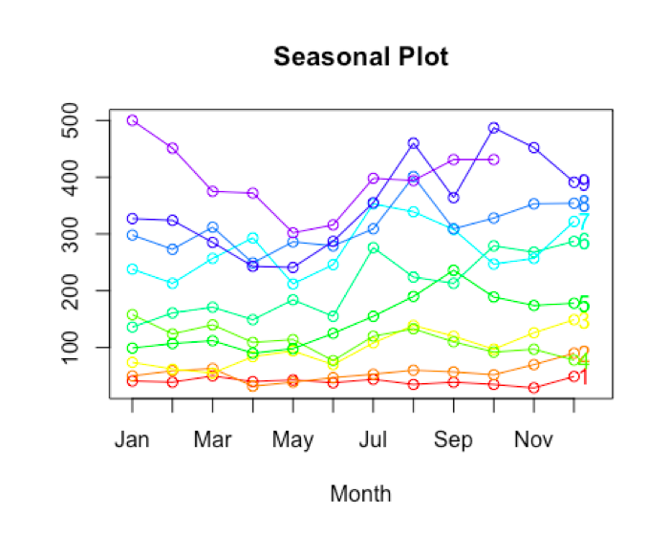
Seasonality
Notes:
Slightly decreasing trend in earlier months
Slightly increasing trend in later months
No clear overall seasonal component due to pattern only holding for some of the data

Slide 6
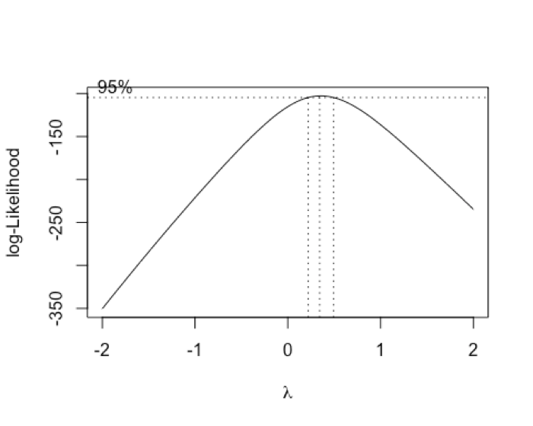
Box Cox
Notes:
Goal is to make variance constant with time
Power parameter
Range does not include 0 so no log transform
Lambda is either ⅓ or ½

Slide 7
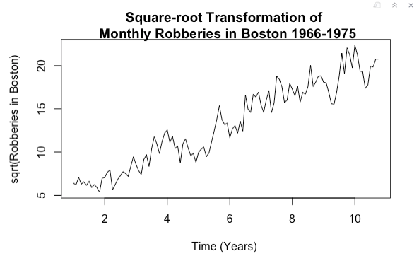
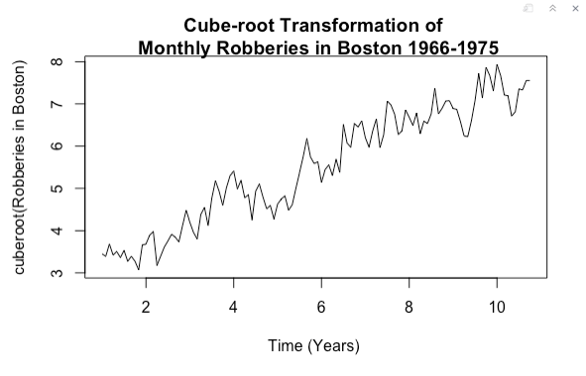
Transformations
Notes:
Cube root has lower variance

Slide 8
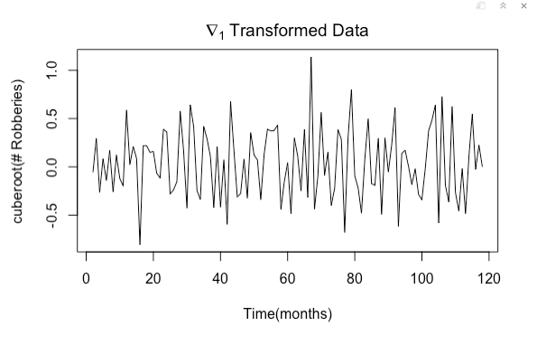
Difference of Transformed Data
Notes:
Will end:
Single difference reduces variance
Second difference increases variance
Assumption of stationarity due to resemblance of white noise
ARIMA(p,1,q)

Slide 9
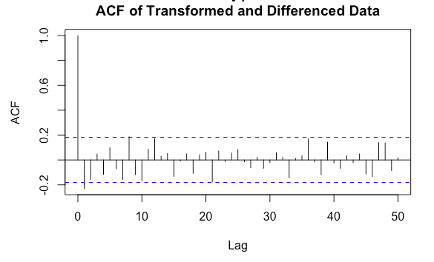
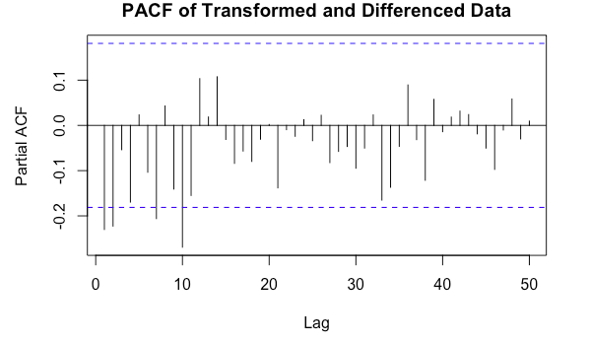
Autocorrelation Analyses of ∇₁(Y^{⅓})
Notes:
ACF cuts off at 1
PACF tails off or cuts off at lag 10
Minimize AIC and BIC for ARIMA(0-10, 1, 0-10)

Slide 10
Model Selection
ARIMA(1,1,2)
p | d | q | AIC | BIC
1 | 1 | 2 | 88.56592 | 99.58028
ARIMA(2,1,2)
p | d | q | AIC | BIC
2 | 1 | 2 | 90.33802 | 104.10597
Notes:
ARIMA(1,1,2) minimizes AIC and BIC
ARIMA(2,1,2) second best BIC

Slide 11
Coefficient Estimation
 | Model 1: ARIMA(1,1,2) | Model 2: ARIMA(2,1,2)
AR(1) | -0.3718 | -0.2991
AR(2) | - | 0.1702
MA(1) | 0.0913 | 0.0266
MA(2) | -0.302 | -0.4532
Notes:
Maximum likelihood estimation
All coefficients necessary to include

Slide 12
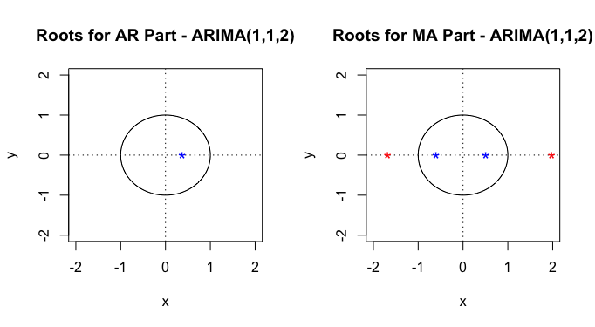
ARIMA(1,1,2) Roots
Notes:
All outside unit circle
Causal and invertible

Slide 13
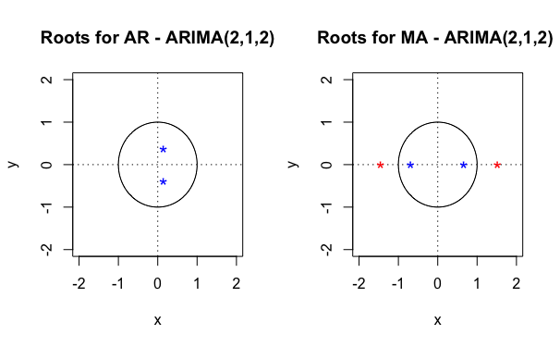
ARIMA(2,1,2) Roots
Notes:
All outside unit circle
Causal and invertible

Slide 14
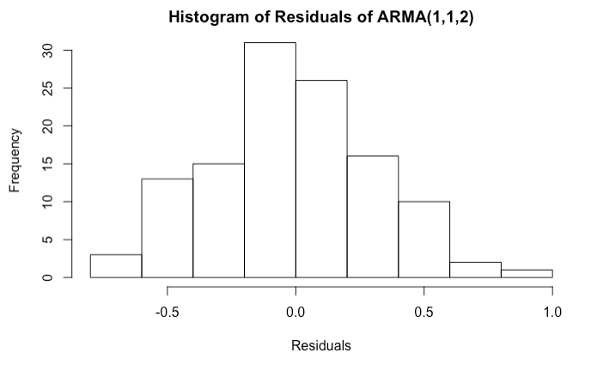
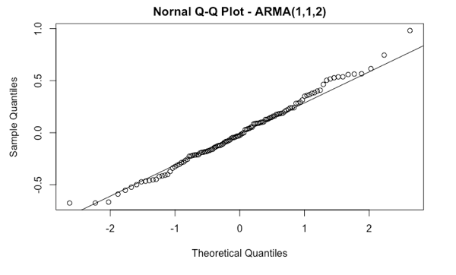
ARIMA(1,1,2) Normality of Residuals
Notes:
Histogram is approximately normal
Q-Q plot is approximately y=x with slight divergence near ends

Slide 15
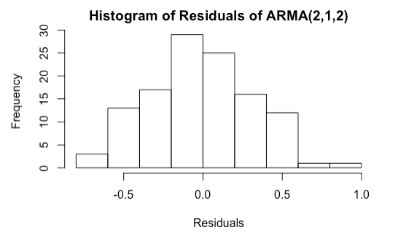
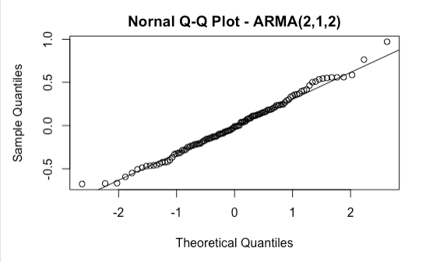
ARIMA(2,1,2) Normality of Residuals
Notes:
Histogram is approximately normal
Q-Q plot is approximately y=x with slight divergence near ends

Slide 16
Error Normality
Shapiro-Wilk Test with 𝝰 = 0.05
H₀= residuals are normally distributed vs. H₁ = residuals are not normally distributed
 | Model 1: ARIMA(1,1,2) | Model 2: ARIMA(2,1,2)
W-Statistic | 0.99125 | 0.9909143
P-Value | 0.6673572 | 0.6362329
Notes:
All tests pass
Fail to reject assumption of normality

Slide 17
Serial Correlation
Box-Pierce and Ljung-Box with 𝝰 = 0.05
H₀= residuals are serially uncorrelated (independent) vs. H₁ = residuals are serially correlated (dependent)
 | Model 1: ARIMA(1,1,2) | Model 2: ARIMA(2,1,2)
Box-Pierce P-Value | 0.1857596 | 0.1931732
Ljung-Box P-Value | 0.1373411 | 0.1427492
Notes:
All tests pass
Fail to reject the null hypotheses that the data are not serially correlated

Slide 18
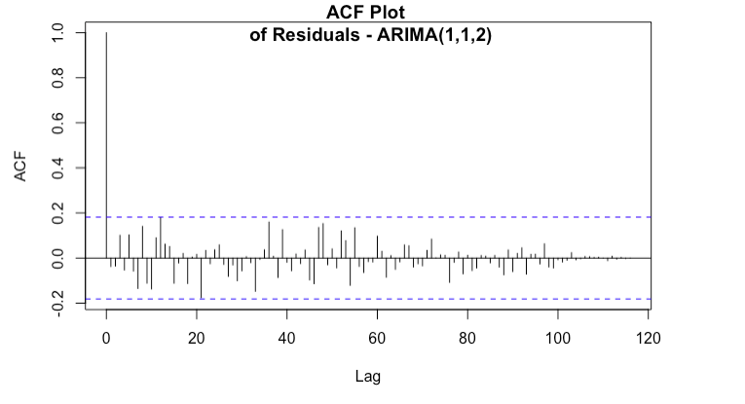
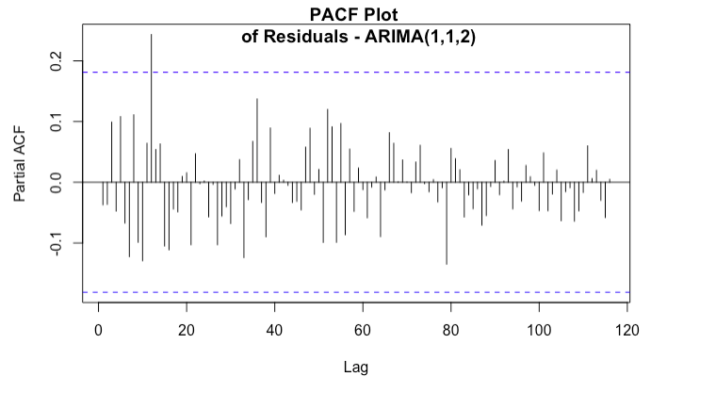
Autocorrelation Analyses of Errors for ARIMA(1,1,2)
Notes:
ACF: all within 95% bounds
PACF: all accept one within 95% bounds

Slide 19
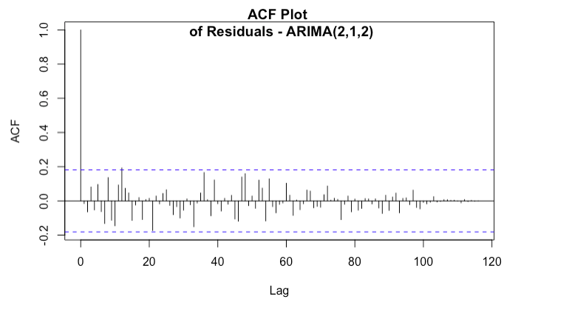
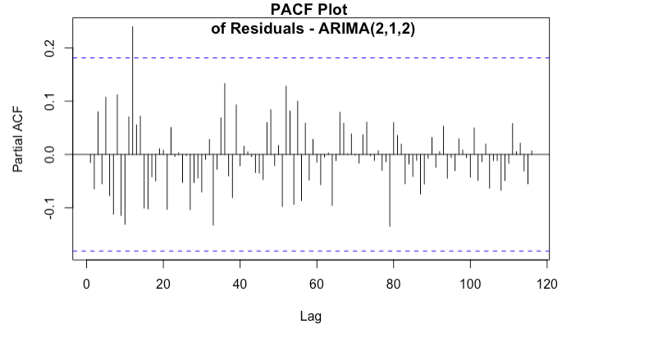
Autocorrelation Analyses of Errors for ARIMA(2,1,2)
Notes:
ACF: all within 95% bounds
PACF: all accept one within 95% bounds

Slide 20
Final Model: ARIMA(1,1,2)
(1+0.37B) X_{t} = (1+0.09B - 0.30B²)Z_{t}
Z_{t} ~ N(0,0.1064543)
Notes:
Both pass all diagnostic tests
Choose one with less parameters based on principle of parsimony
Where X_{t} is the transformed and differenced data, ∇₁Y_{t}^{1/3}

Slide 21
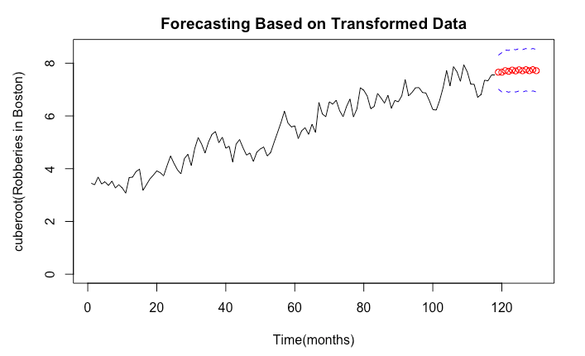
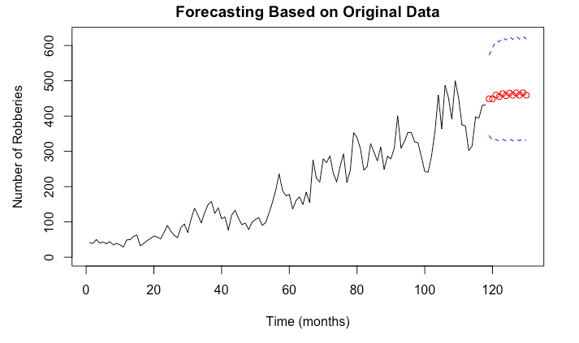
Forecasting
Notes:
We forecast using the innovation algorithm so that both the AR and MA portions are taken into account. Forecasted 12 steps ahead, basically one year of data points. Then back transform to the original data set. Red dots are forecasted values and blue dotted lines are the 95% prediction interval for these forecasted values.

Slide 22
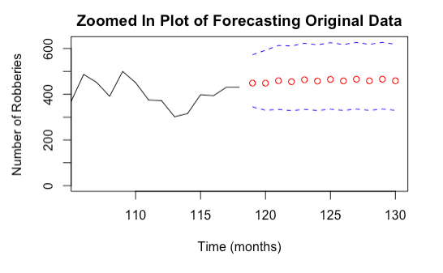
Forecasting
Notes:
Actual data from Massachusetts Crime Rates - Public Records lies within predicted interval

Slide 23
References
Data Market, https://datamarket.com/data/set/22ob/monthly-boston-armed-robberies-jan1966-oct1975-deutsch-and-alt-1977#!ds=22ob&display=line
Massachusetts Crime Rates 1960 - 2016 - Public Records,
http://www.disastercenter.com/crime/macrime.htm

Slide 24
questions…?

